Slide 1

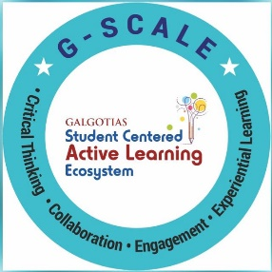
Machine Learning Approaches overview (Regression, Classification, Clustering, Reinforcement Learning, Genetic Algorithm), Issues in Machine Learning
Session No.: 05
Course Name: Machine Learning
Course Code: R1UC525B
Instructor Name: Dr. Sivakumar Madeshwaran
Duration: 50 Minutes
Date of Conduction of Class: 21-08-2026

Slide 2

Recap
1. Which of the following metrics is NOT used for regression tasks?
a) Mean Absolute Error (MAE)
b) Root Mean Squared Error (RMSE)
c) R² Score
d) F1 Score
2. In classification, Recall can be defined as:
a) TP / (TP + FP)
b) TP / (TP + FN)
c) TN / (TN + FP)
d) (TP + TN) / (Total Samples)
3. (True/False)
Silhouette Score is a performance metric used in supervised classification tasks.

Slide 3
Recap - Reflections
1. Which of the following metrics is NOT used for regression tasks?
a) Mean Absolute Error (MAE)
b) Root Mean Squared Error (RMSE)
c) R² Score
d) F1 Score
2. In classification, Recall can be defined as:
a) TP / (TP + FP)
b) TP / (TP + FN)
c) TN / (TN + FP)
d) (TP + TN) / (Total Samples)
3. (True/False)
Silhouette Score is a performance metric used in supervised classification tasks.
Answer: False

Slide 4
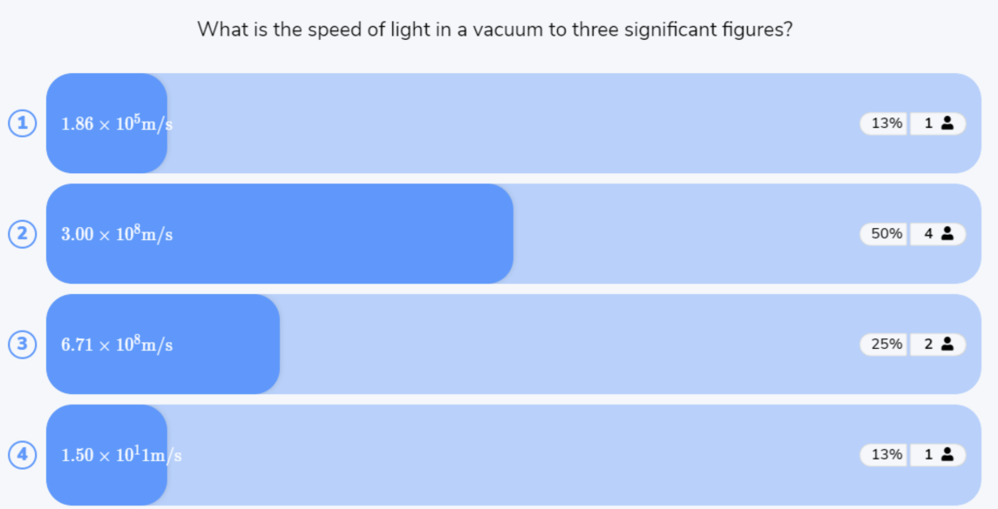
Reflect on the responses of post session activity

Slide 5




“How can a machine learning system learn to make predictions or decisions from data?”
Opening Question

Slide 6
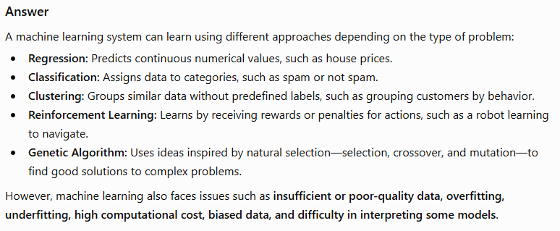
Opening Question -Reflections

Slide 7
At the end of this session students will be able to
LO1: Explain and differentiate major machine learning approaches, including Regression, Classification, Clustering, Reinforcement Learning, and Genetic Algorithms, with suitable examples.
LO2: Identify and discuss key issues in machine learning.

Slide 8
Session Outline
1 Overview of the Different Approaches in Machine Learning
2 Activity-1 (Think –Pair -Share)
3 Issue in ML
4 Activity-2 (Quiz on Wooflash)
5 Review and Reflections

Slide 9
Different Approaches in Machine Learning
Machine Learning can broadly be divided into several approaches depending on the type of task, supervision and learning strategy.
Classification
Definition: A supervised learning method where the output is a discrete label (category).
Goal: Classify input data into one of several classes.
Examples:
  Spam vs. Not Spam email detection.
  Handwritten digit recognition.
  Disease diagnosis (positive/negative).
Common Algorithms:
  Logistic Regression
  Decision Trees & Random Forests
  Naïve Bayes
  k-Nearest Neighbors (KNN)
  Support Vector Machines (SVM)
  Neural Networks

Slide 10
Different Approaches in Machine Learning
Regression
Definition: A supervised learning method where the output is a continuous value.
Goal: Predict numerical outcomes based on input features.
Examples:
Predicting house prices from size, location, and amenities.
Estimating stock prices.
Common Algorithms:
Linear Regression
Polynomial Regression
Ridge and Lasso Regression
Support Vector Regression (SVR)
Neural Network Regression

Slide 11
Different Approaches in Machine Learning
Clustering
Definition: An unsupervised learning technique where data is grouped into clusters based on similarity.
Goal: Discover hidden patterns or groupings without labeled data.
Examples:
  Customer segmentation in marketing.
  Image compression.
  Grouping genes with similar expression patterns.
Common Algorithms:
  k-Means Clustering
  Hierarchical Clustering
  DBSCAN

Slide 12
Different Approaches in Machine Learning
Reinforcement Learning (RL)
Definition: A learning approach where an agent interacts with an environment, learning through trial and error by receiving rewards or penalties.
Goal: Maximize cumulative reward by learning the best strategy (policy).
Examples:
  Game playing (Chess, Go, Atari).
  Self-driving cars.
  Robotics path planning.
Key Concepts:
  Agent, Environment, State, Action, Reward.
  Policies (mapping from state → action).
  Value functions (estimating long-term rewards).
Common Algorithms:
  Q-Learning
  Deep Q-Networks (DQN)

Slide 13
Different Approaches in Machine Learning
Genetic Algorithm (GA)
Definition: An optimization and search heuristic inspired by natural evolution (Darwin’s survival of the fittest).
Goal: Evolve the best solution to a problem using genetic operators.
Process:
  Initialize population (candidate solutions).
  Evaluate fitness of each candidate.
  Select parents based on fitness.
  Apply crossover and mutation.
  Generate new population → repeat until optimal solution found.
Applications:
  Feature selection in ML.
  Neural network weight optimization.
  Scheduling and planning problems.

Slide 14
Learning Activity-1: Think-pair-share
If you had to teach a computer to predict house prices, spam email, group customers by buying habits, or play chess, what would you need to give it first?
Problem | Approaches | How
Predict house price | Regression | Training data with house size, location, price.
Spam email | Classification | Emails labeled spam / not spam.
Group customers by buying habits | Clustering | Purchase history (no labels).
Play chess | Reinforcement Learning | Rewards for wins/losses.
Optimization | Genetic Algorithm | Find out best solution

Slide 15
Issues in Machine Learning
Despite its power, ML faces several challenges:
1. Data-Related Issues
Insufficient Data: ML needs lots of labeled data; small datasets → overfitting.
Noisy Data: Incorrect or inconsistent data reduces accuracy.
Imbalanced Data: Some classes dominate (e.g., fraud detection → very few fraud cases).
High Dimensionality: Too many features (curse of dimensionality).
2. Algorithmic Issues
Overfitting: Model learns noise instead of patterns → poor generalization.
Underfitting: Model too simple → fails to capture relationships.
Scalability: Many algorithms don’t work well with big data.
Model Interpretability: Complex models (deep learning) are black-boxes.
3. Computational Issues
High Computational Cost: Training large ML models is resource-intensive.
Real-Time Learning: Some applications (self-driving cars) need instant decisions.

Slide 16

Activity 2: Rapid Quiz

Slide 17
Summary
Machine Learning offers multiple approaches — Regression, Classification, Clustering, Reinforcement Learning, and Genetic Algorithms — each suitable for different types of problems.
Success in ML heavily depends on quality training data, proper concept representation, and effective function approximation.
While ML provides powerful solutions across domains (healthcare, finance, robotics, etc.), it faces challenges such as data limitations, algorithmic trade-offs, scalability, interpretability, and ethical concerns.
Future directions focus on developing more explainable, fair, efficient, and robust ML systems that can work effectively in real-world, dynamic environments.

Slide 18
Ensure attainment of LOs in alignment to the learning activities: outcomes (1-2)
LO1: Explain and differentiate major machine learning approaches, including Regression, Classification, Clustering, Reinforcement Learning, and Genetic Algorithms, with suitable examples.
LO2: Identify and discuss key issues in machine learning.

Slide 19

Post Session Activity

Slide 20
Information about the next lesson
Data Science vs ML vs Deep Learning, Types of Learning: Supervised, Unsupervised, Reinforcement

Slide 21


Review and Reflection from students

